Slide 1


CMR TECHNICAL CAMPUS
UGC(Autonomous)
Kandlakoya,Medchal Road,Hyd-501 401 Department of Computer Science Engineering
Major Project On
CREDIT CARD FRAUD DETECTION USING STATE OF THE ART USING MACHINE LEARNING AND DEEP LEARNING ALGORITHM
BATCH NO : 22
Project Guide: BATCH MEMBERS:
Ms. Saba Sultana 207R1A0595 M RISHITHA REDDY
Assistant Professor, CSE Department 207R1A0580 GUGLAVATH SRISHANTH
217R5A0508 MARIPEDDA PRAVEEN
Project Coordinator:
J.Narasimharao
Associate Professor, CSE Department

Slide 2
CONTENTS
Abstract
Existing System
Disadvantages of Existing System
Proposed System
Advantages of Proposed System
System Requirements
Novelty
System Architecture
Modules
UML Diagrams
Sample Code
Results
Conclusion
Future Scope
References

Slide 3
ABSTRACT
Credit cards have become an integral part of modern financial transactions, providing users with a convenient and widely accepted method of payment. The widespread use of credit cards, both online and offline, has, however, given rise to the escalating threat of credit card fraud.
Fraudulent activities such as unauthorized transactions, identity theft, and skimming pose substantial risks to financial institutions and cardholders. With the increasing prevalence of online transactions, the risk of credit card fraud has become a major concern for financial institutions and users alike.
This study proposes an advanced Credit Card Fraud Detection system leveraging state-of-the-art machine learning and deep learning algorithms to enhance the accuracy and efficiency of fraud detection.

Slide 4
EXISTING SYSTEM
The current system for detecting credit card fraud uses a mix of rules, statistics, and machine learning. It looks at transaction data, finds patterns that suggest fraud, and uses algorithms to separate real transactions from fraudulent ones.
The ensemble of the decision tree is the random forest. Most researchers use the RF approach. To combine the model, we can use (RF) along with network analysis.
ML algorithms, such as LR, ANN, DT, SVM and NB, are commonly used for CCF detection. The researcher can combine these techniques with ensemble techniques to construct solid detection classifiers.
An artificial neural network consists of interconnected nodes organized in layers, including input, hidden, and output layers.
These nodes receive inputs, multiply them by weights, add biases, apply activation functions, and pass the result to the next layer, eventually producing an output. Training involves adjusting weights using algorithms like back propagation to minimize errors

Slide 5
DISADVANTAGES OF EXISTING SYSTEM
The system is not implemented Classification on Imbalanced Data.
The system is not implemented CONVOLUTIONAL NEURAL NETWORK (CNN) for test and train the datasets.

Slide 6
PROPOSED SYSTEM
This project leverages advanced techniques such as deep neural networks and anomaly detection methods to better identify fraudulent transactions.
In this project, Feature selection algorithms are used to rank the top features from the
CCF transaction dataset, which help in class label predictions.
The deep learning model is proposed by adding a number of additional layers that are then used to extract the features and classification from the credit card fraud detection dataset.
To assess the accuracy of the classifiers, performance evaluation measures, accuracy,
precision, and recall are used.
The performance of the proposed CNN model is compared with both traditional ML algorithms (presumably applied after feature selection) and baseline DL models. The results demonstrate that the proposed approach achieves superior performance.

Slide 7
ADVANTAGES OF PROPOSED SYSTEM
The proposed system uses SUPERVISED MACHINE LEARNING APPROACHES which are effective for testing and training datasets.
The proposed system implemented CNN is to minimize processing without losing key features by reducing the image to make predictions.

Slide 8
SYSTEM REQUIRMENTS
HARDWARE REQUIRMENTS
• System Processor : Intel core i3 or above
Hard Disk : Minimum of 8GB and above
Ram : Minimum of 8GB and above

Slide 9
SOFTWARE REQUIRMENTS
Operating Systems : Window 8 or above
Coding Languages : Python
Front-End : Python.
Back-End : Django-ORM
Designing : HTML, CSS, Javascript
Data Base : MySQL (WAMP Server).

Slide 10
NOVELTY OF PROJECT
The novelty of the proposed project lies in its comprehensive approach to fraud detection in credit card transactions. Unlike existing systems that primarily rely on traditional machine learning (ML) techniques like random forests and neural networks, the proposed system integrates both ML and deep learning (DL) algorithms.
By leveraging feature selection algorithms to identify key indicators of fraud and implementing a deep learning model with additional layers for feature extraction, the project aims to enhance the accuracy and efficiency of fraud detection.
Utilization of performance evaluation measures like accuracy, precision, and recall, the project seeks to advance the state-of-the-art in fraud detection technology, ultimately contributing to more robust and effective security measures in the financial sector.
The project conducts a comparative analysis between ML with DL algorithms and a proposed convolutional neural network (CNN) model, demonstrating superior performance.

Slide 11
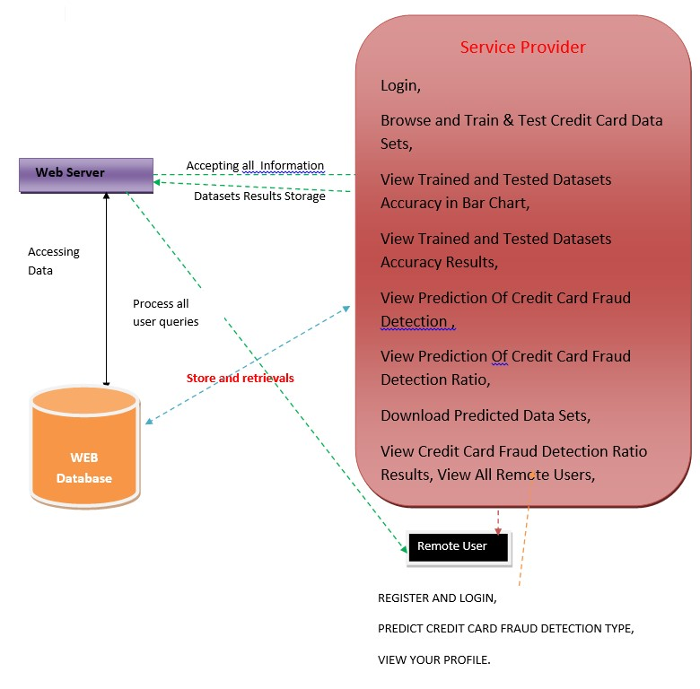
ARCHITECTURE

Slide 12
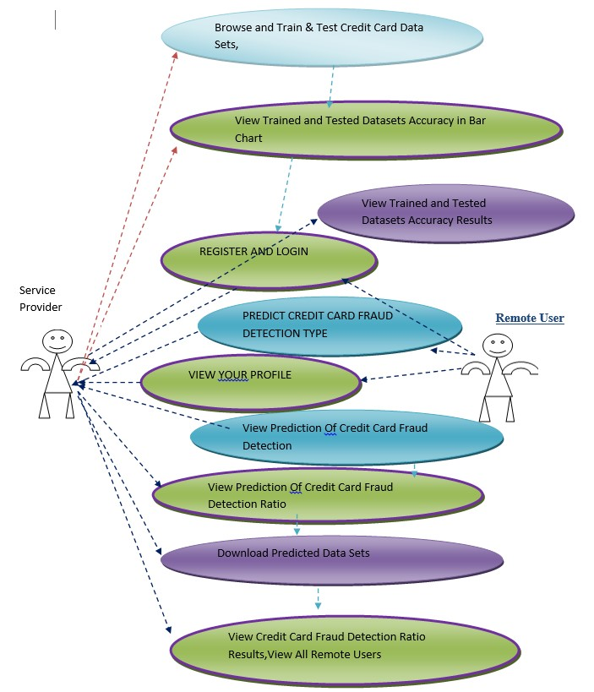










UML DIAGRAMS
USE CASE DIAGRAM

Slide 13
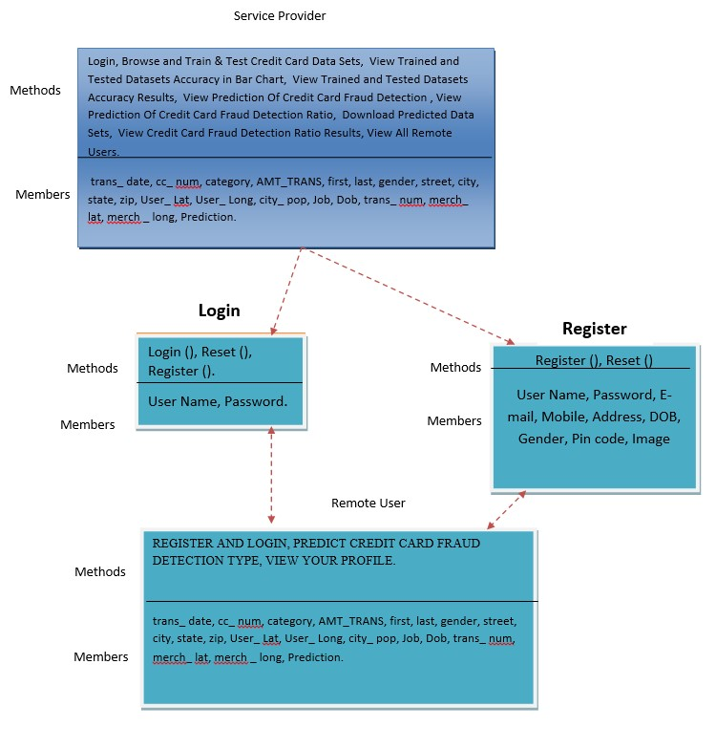
CLASS DIAGRAM

Slide 14
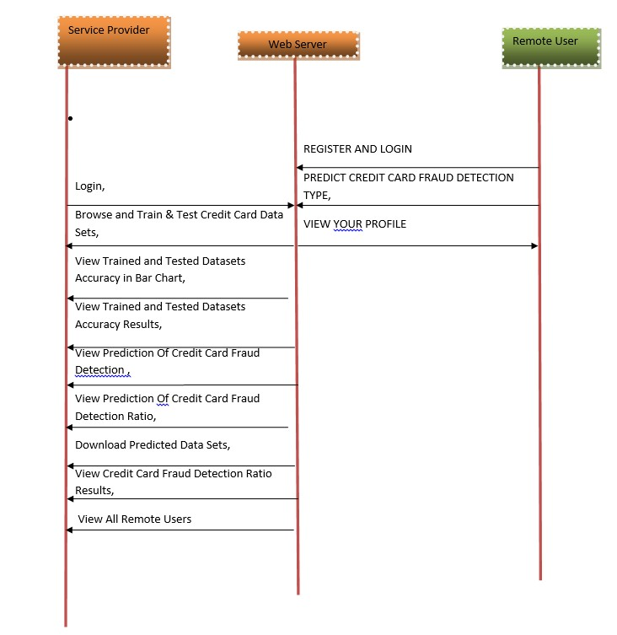
SEQUENCE DIAGRAM

Slide 15
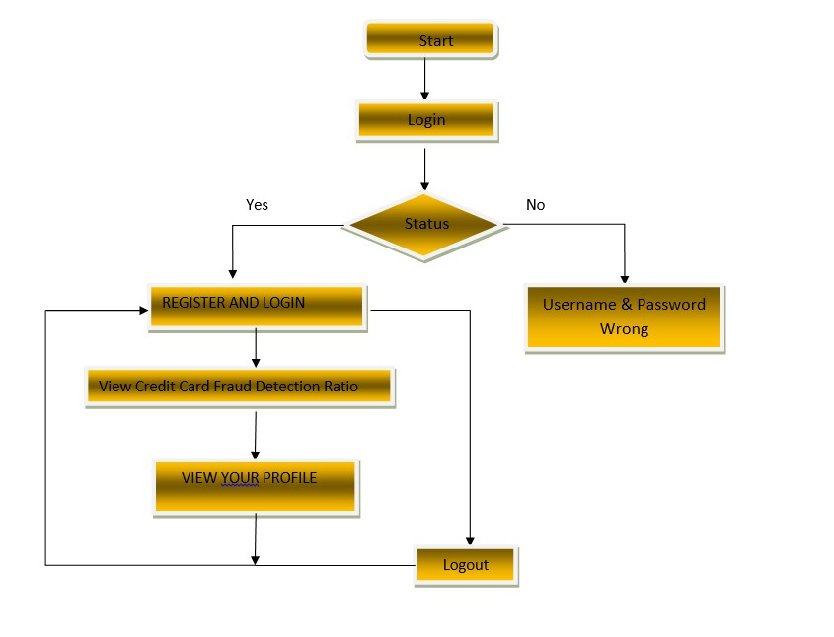
ACTIVITY DIAGRAM

Slide 16
SAMPLE CODE
rom django.db.models import Count, Avg
from django.shortcuts import render, redirect
from django.db.models import Count
from django.db.models import Q
import datetime
import xlwt
from django.http import HttpResponse
import pandas as pd
from sklearn.feature_extraction.text import CountVectorizer
from sklearn.metrics import accuracy_score, confusion_matrix, classification_report
from sklearn.metrics import accuracy_score
from sklearn.tree import DecisionTreeClassifier
# Create your views here.
from Remote_User.models import ClientRegister_Model,cc_fraud_detection_type,detection_ratio,detection_accuracy

Slide 17
def serviceproviderlogin(request):
if request.method == "POST":
admin = request.POST.get('username')
password = request.POST.get('password')
if admin == "Admin" and password =="Admin":
detection_accuracy.objects.all().delete()
return redirect('View_Remote_Users')
return render(request,'SProvider/serviceproviderlogin.html')
def View_CC_Fraud_Detection_Ratio(request):
detection_ratio.objects.all().delete()
ratio = ""
kword = 'No Credit Card Fraud'
print(kword)
obj = cc_fraud_detection_type.objects.all().filter(Q(Prediction=kword))
obj1 = cc_fraud_detection_type.objects.all()
count = obj.count();
count1 = obj1.count();
ratio = (count / count1) * 100
if ratio != 0:
detection_ratio.objects.create(names=kword, ratio=ratio)

Slide 18
ratio = ""
kword = 'No Credit Card Fraud'
print(kword)
obj = cc_fraud_detection_type.objects.all().filter(Q(Prediction=kword))
obj1 = cc_fraud_detection_type.objects.all()
count = obj.count();
count1 = obj1.count();
ratio = (count / count1) * 100
if ratio != 0:
detection_ratio.objects.create(names=kword, ratio=ratio)
ratio12 = ""
kword12 = 'Credit Card Fraud'
print(kword12)
obj12 = cc_fraud_detection_type.objects.all().filter(Q(Prediction=kword12))
obj112 = cc_fraud_detection_type.objects.all()
count12 = obj12.count();
count112 = obj112.count();
ratio12 = (count12 / count112) * 100
if ratio12 != 0:

Slide 19
def View_Remote_Users(request):
obj=ClientRegister_Model.objects.all()
return render(request,'SProvider/View_Remote_Users.html',{'objects':obj})
def charts(request,chart_type):
chart1 = detection_ratio.objects.values('names').annotate(dcount=Avg('ratio'))
return render(request,"SProvider/charts.html", {'form':chart1, 'chart_type':chart_type})
def charts1(request,chart_type):
chart1 = detection_accuracy.objects.values('names').annotate(dcount=Avg('ratio'))
return render(request,"SProvider/charts1.html", {'form':chart1, 'chart_type':chart_type})
def View_Prediction_Of_CC_Fraud_Detection(request):
obj =cc_fraud_detection_type.objects.all()
return render(request, 'SProvider/View_Prediction_Of_CC_Fraud_Detection.html', {'list_objects': obj})
def likeschart(request,like_chart):
charts =detection_accuracy.objects.values('names').annotate(dcount=Avg('ratio'))
return render(request,"SProvider/likeschart.html", {'form':charts, 'like_chart':like_chart})
def Download_Predicted_DataSets(request):

Slide 20
from sklearn.ensemble import GradientBoostingClassifier
clf = GradientBoostingClassifier(n_estimators=100, learning_rate=1.0, max_depth=1, random_state=0).fit(
X_train,
y_train)
clfpredict = clf.predict(X_test)
print("ACCURACY")
print(accuracy_score(y_test, clfpredict) * 100)
print("CLASSIFICATION REPORT")
print(classification_report(y_test, clfpredict))
print("CONFUSION MATRIX")
print(confusion_matrix(y_test, clfpredict))
models.append(('GradientBoostingClassifier', clf))
detection_accuracy.objects.create(names="Gradient Boosting Classifier",
ratio=accuracy_score(y_test, clfpredict) * 100)
csv_format = 'Results.csv'
df.to_csv(csv_format, index=False)
df.to_markdown
obj = detection_accuracy.objects.all()
return render(request,'SProvider/train_model.html', {'objs': obj})

Slide 21
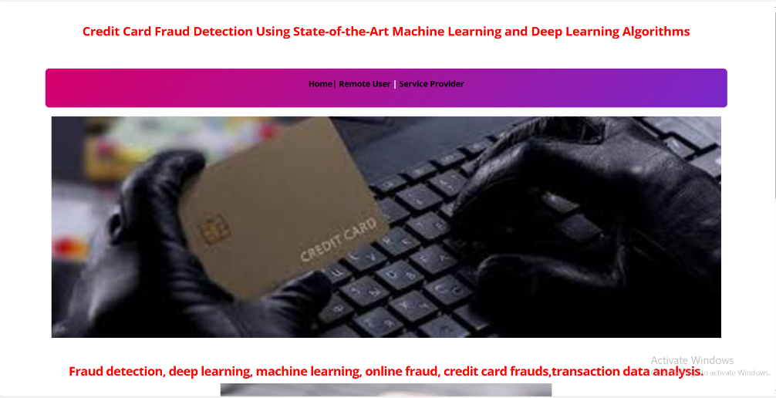
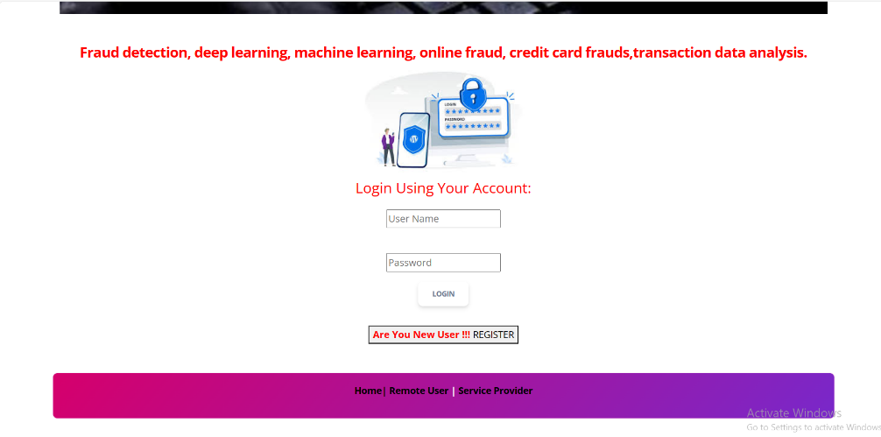
RESULTS

Slide 22
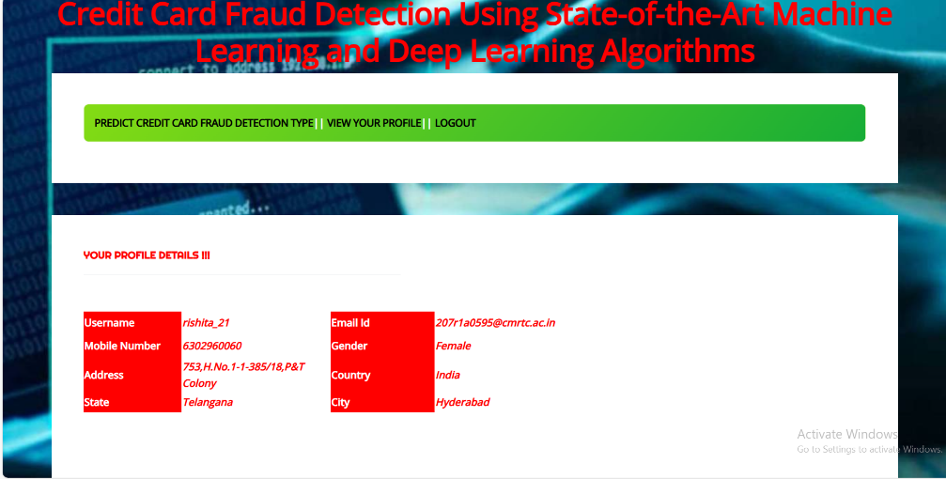
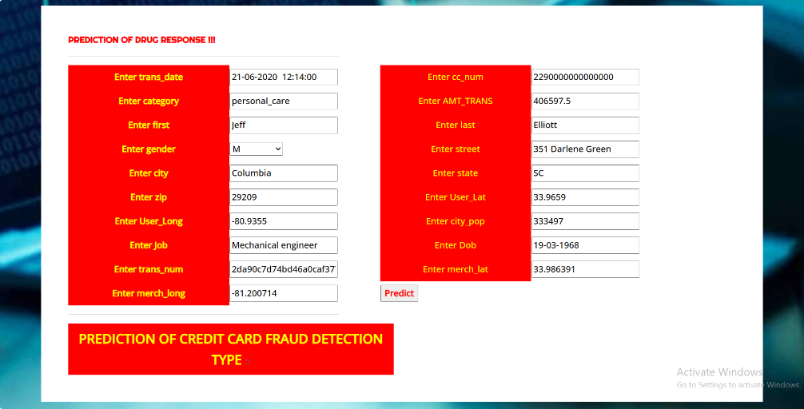

Slide 23
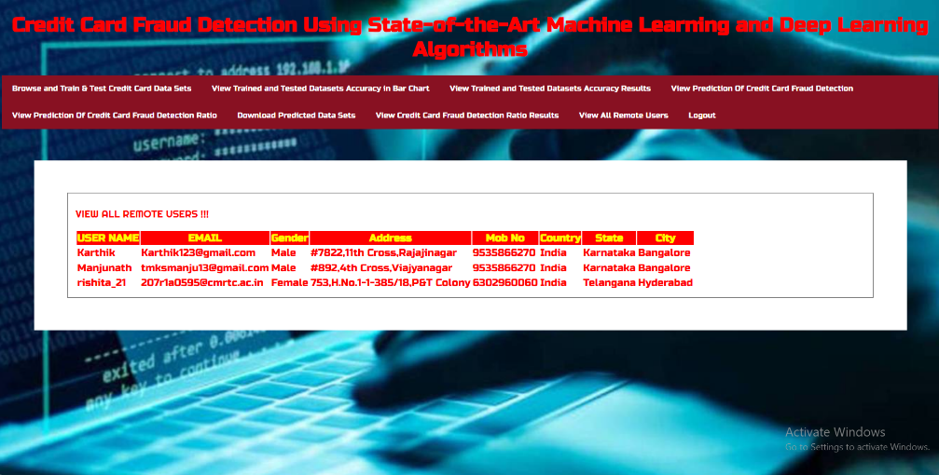
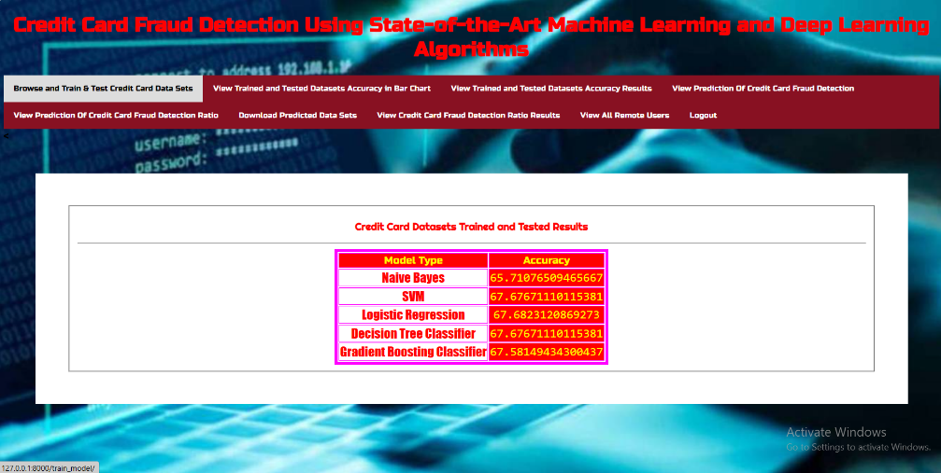

Slide 24
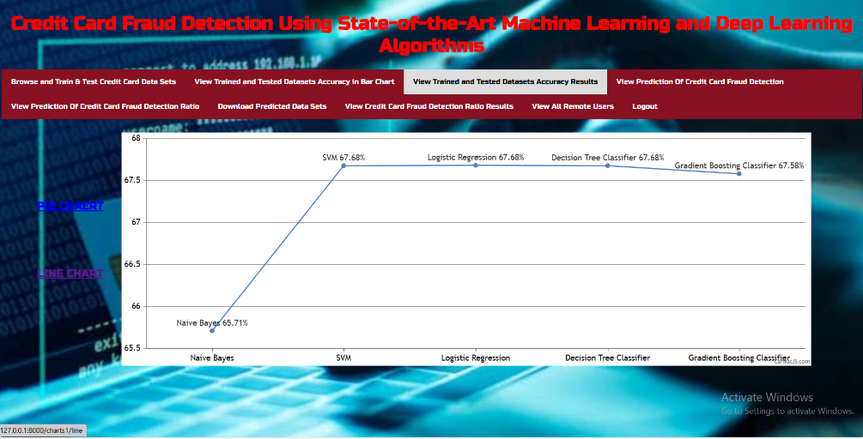
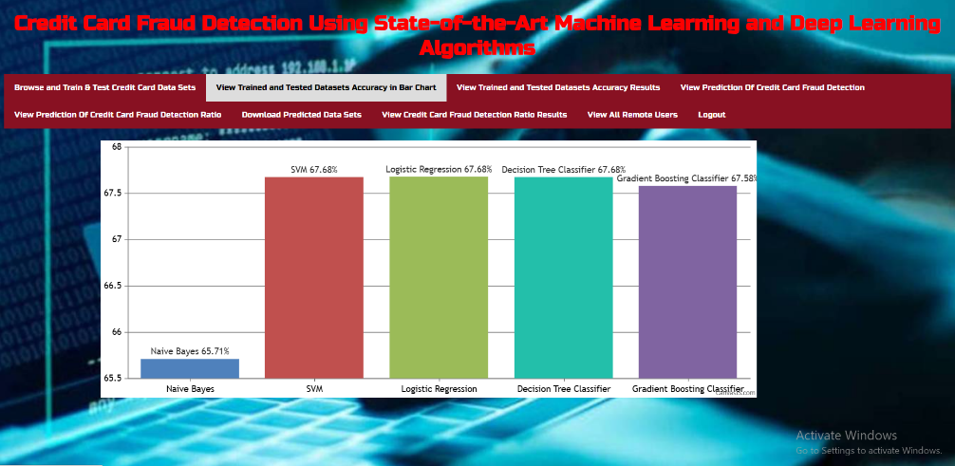

Slide 25
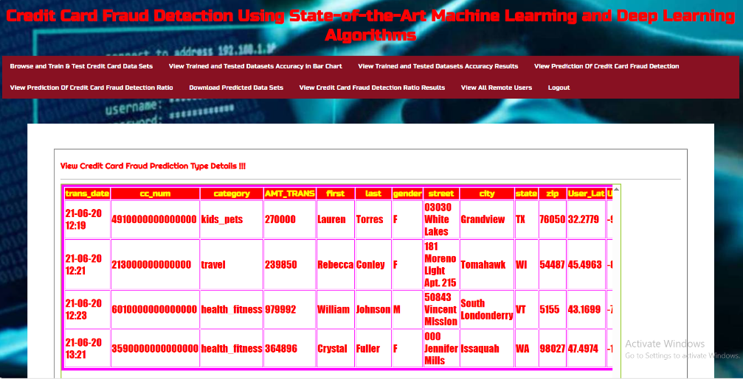
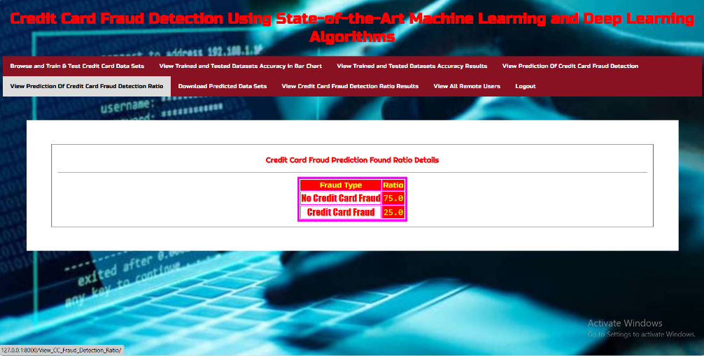

Slide 26
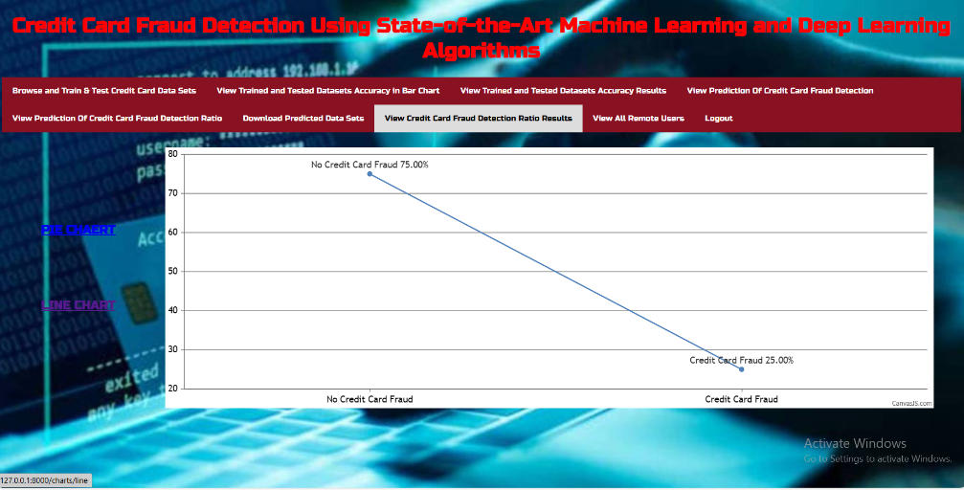

Slide 27
CONCLUSION
CCF is an increasing threat to financial institutions. Accurately predicting fraud cases and reducing false-positive cases is the foremost priority of a fraud detection system.
The performance of ML methods varies for each individual business case. The type of input data is a dominant factor that drives different ML methods. For detecting CCF, the number of features, number of transactions, and correlation between the features are essential factors in determining the model's performance.
DL methods, such as CNNs and their layers, are associated with the processing of text and the baseline model. Using these methods for the detection of credit cards yields better performance than traditional algorithms.
Comparing all the algorithm performances side to side, the CNN with 20 layers and the baseline model is the top method with an accuracy of 99.72%. Numerous sampling techniques are used to increase the performance of existing examples, but they significantly decrease on the unseen data.

Slide 28
FUTURE SCOPE
The future scope for this project involves further advancements in fraud detection by exploring novel feature selection techniques tailored to the nuances of credit card transaction data.
Continuously refining deep learning architectures, including convolutional neural networks (CNNs), by experimenting with diverse layers and configurations, can unlock even greater predictive power. Additionally, future endeavors could delve into ensemble methods to combine the strengths of multiple models for more robust and accurate fraud detection systems. Further research may also focus on enhancing interpretability and explainability of these models, ensuring transparency and trustworthiness in decision-making processes.
Collaboration with financial institutions and regulatory bodies can facilitate the integration of these cutting-edge techniques into real-world applications, ultimately bolstering the security and efficiency of credit card transactions on a broader scale.

Slide 29
REFERENCES
1. Y. Abakarim, M. Lahby, and A. Attioui, ‘‘An efficient real time model for credit card fraud detection
based on deep learning,’’ in Proc. 12th Int. Conf. Intell. Systems: Theories Appl., Oct. 2018, pp. 1–7, doi:
10.1145/3289402.3289530.
2. H. Abdi and L. J. Williams, ‘‘Principal component analysis,’’ Wiley Interdiscipl. Rev., Comput. Statist.,
vol. 2, no. 4, pp. 433–459, Jul. 2010, doi: 10.1002/wics.101.
3. V. Arora, R. S. Leekha, K. Lee, and A. Kataria, ‘‘Facilitating user authorization from imbalanced data
logs of credit cards using artificial intelligence,’’ Mobile Inf. Syst., vol. 2020, pp. 1–13, Oct. 2020, doi:
10.1155/2020/8885269.
4. A. O. Balogun, S. Basri, S. J. Abdulkadir, and A. S. Hashim, ‘‘Performance analysis of feature selection
methods in software defect prediction: A search method approach,’’ Appl. Sci., vol. 9, no. 13, p. 2764,
Jul. 2019, doi: 10.3390/app9132764.

Slide 30
THANK YOU

